Slide 1
Ibn Battuta A Gift to Those Who Contemplate the Wonders of Cities and the Marvels of Travelling

Slide 2
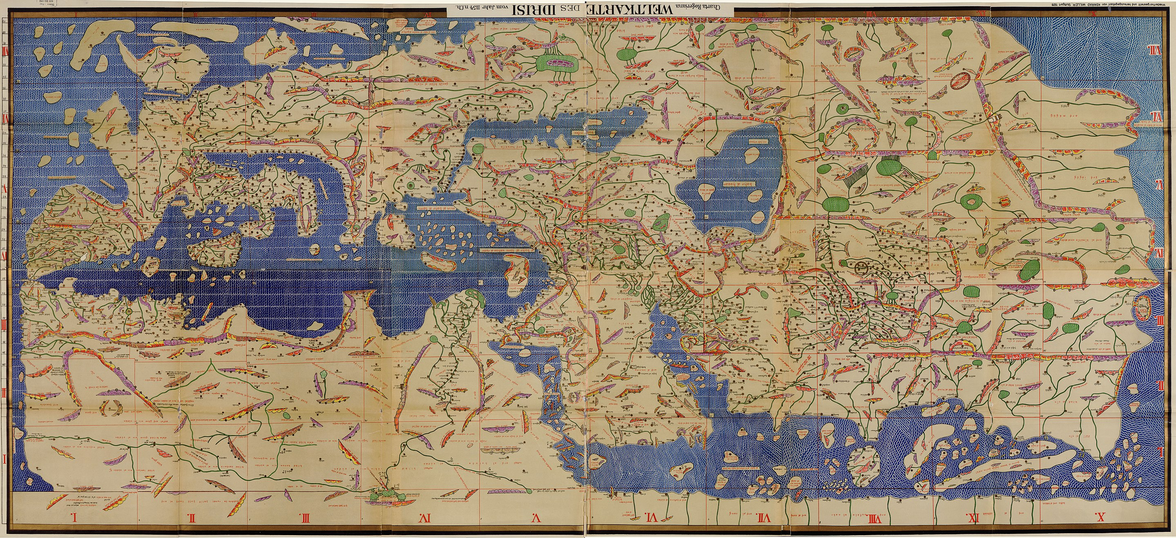
al-Idrisi, Tabula Rogeriana (1154)

Slide 3
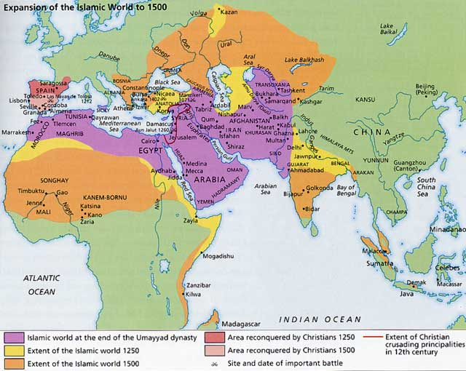
Islamic World, c. 700-1500

Slide 4
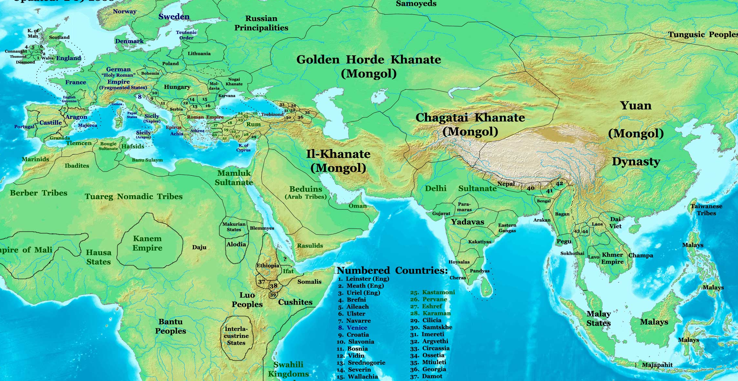
Political Divisions (c. 1300)

Slide 5
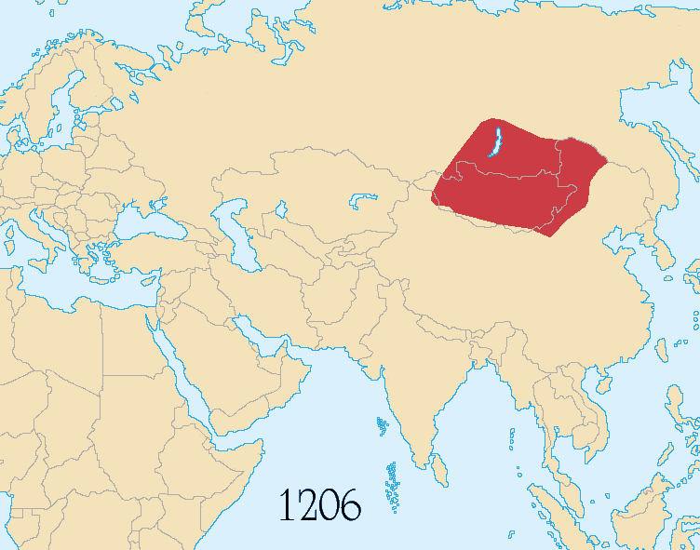
Mongol Empire
Territory from 1206-1294

Slide 6
Political Divisions (c. 1300)

Slide 7
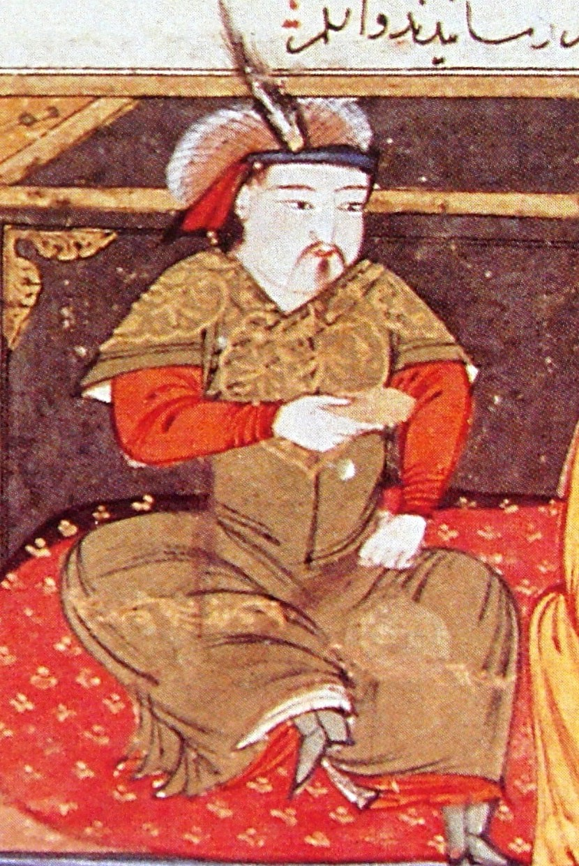
Hulagu Khan
(c. 1218 - 1265)
Rashid-al-Din Hamadani
Early 14th c.

Slide 8
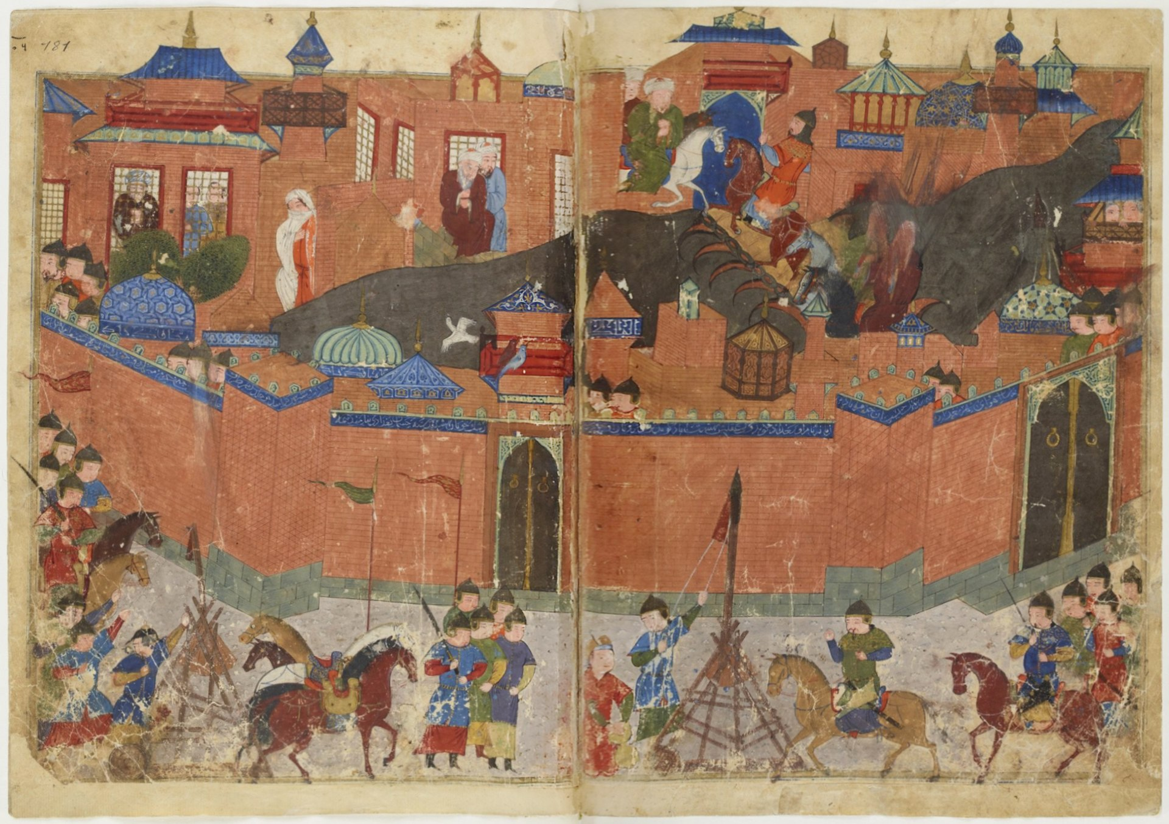
Siege of Baghdad (1258)

Slide 9
Ozbeg/Uzbeg Khan
(r. 1313 - 1341)
“By the will and power, the greatness and most high! Let no man insult the metropolitan church of which Peter is head, or his service or his churchman; let no man seize their property, goods or people, let no man meddle in the affairs of the church [...] Their laws, their churches and monasteries and chapels shall be respected; whoever condemns or blames this religion, shall not be allowed to excuse himself under any pretext, but shall be punished with death.”
- Ozbeg Khan to Saint Peter, the Metropolitan Bishop of Moscow

Slide 10
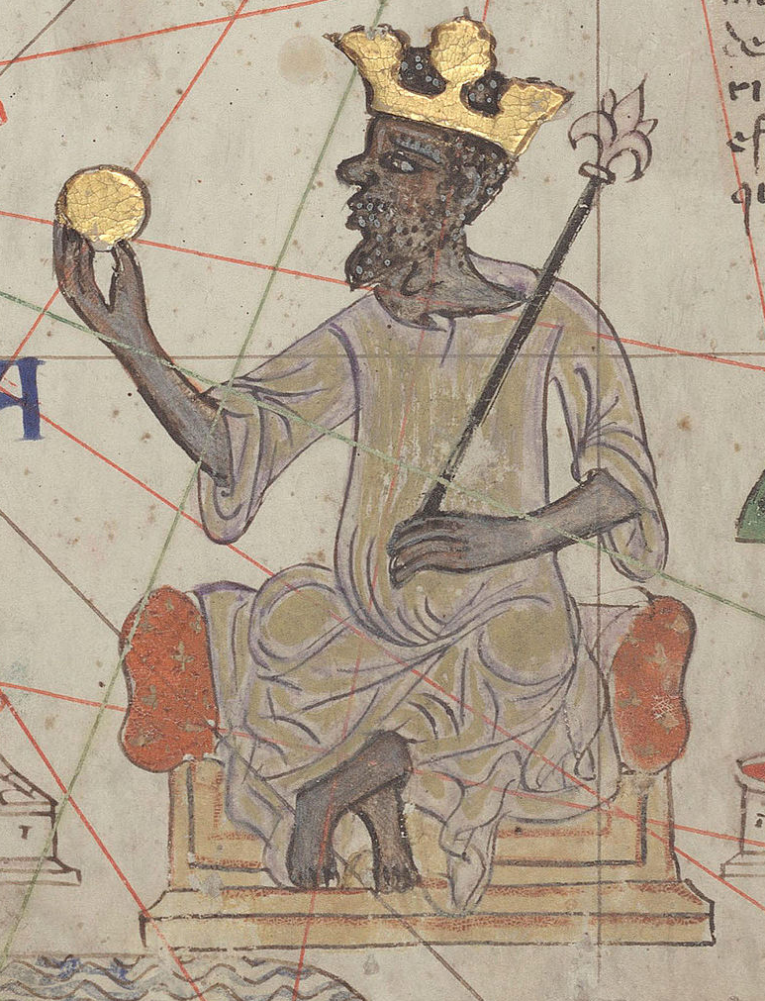
Mansa Musa
(c.1280-1337)
Catalan Atlas
c. 1375

Slide 11
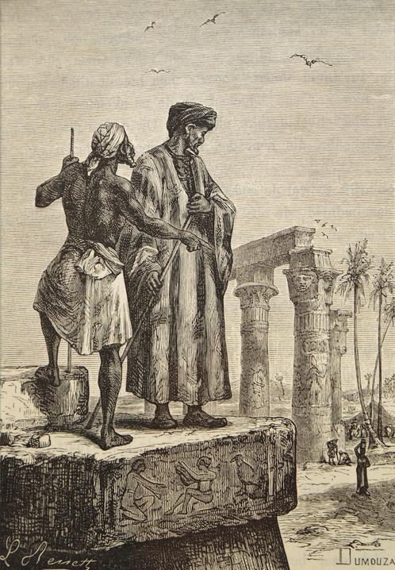
Ibn Battuta
(1304 - 1368/9)
Léon Benett (1878)
Engraving

Slide 12
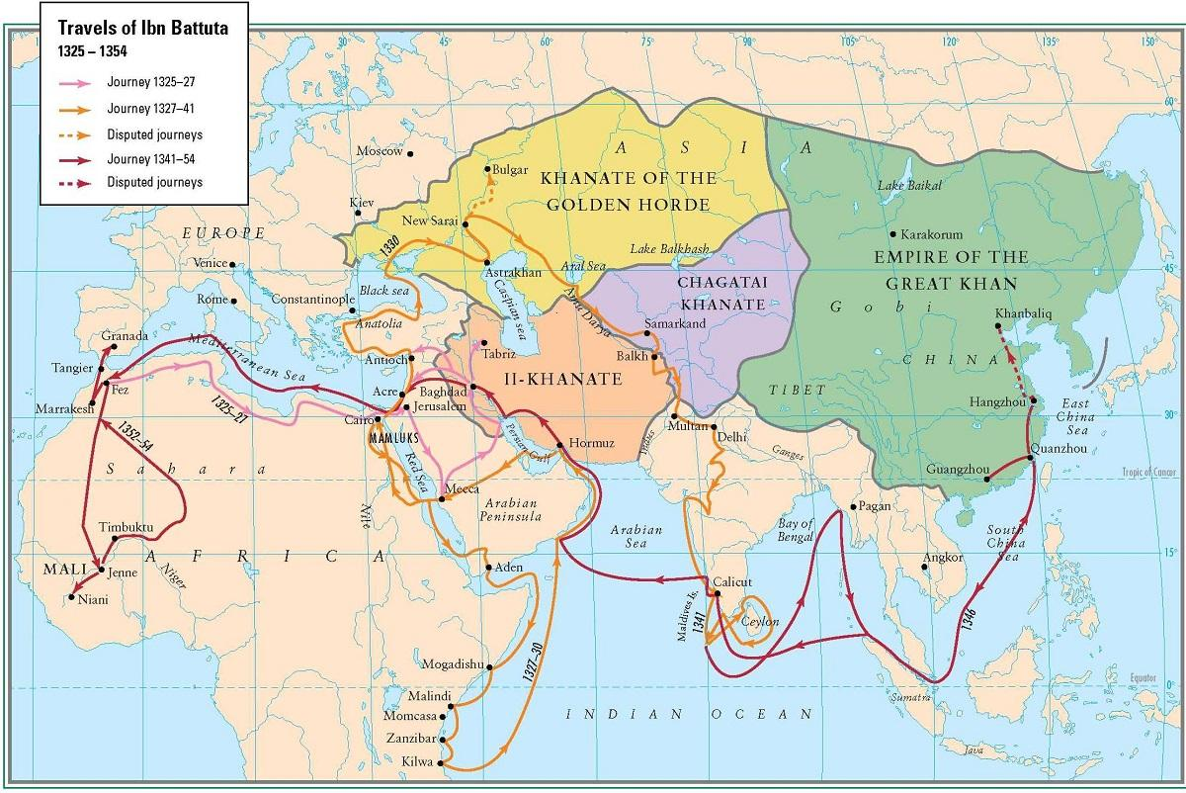
Ibn Battuta’s Travels

Slide 13
Medieval World (c. 1300)

Slide 14
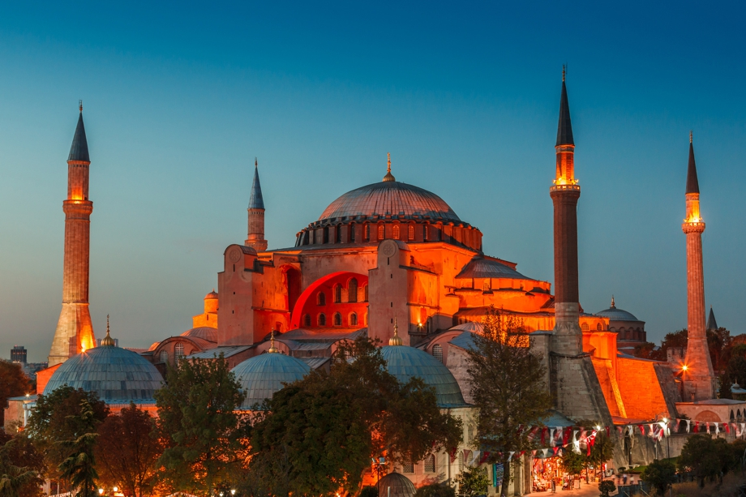
Hagia Sophia (537)

Slide 15
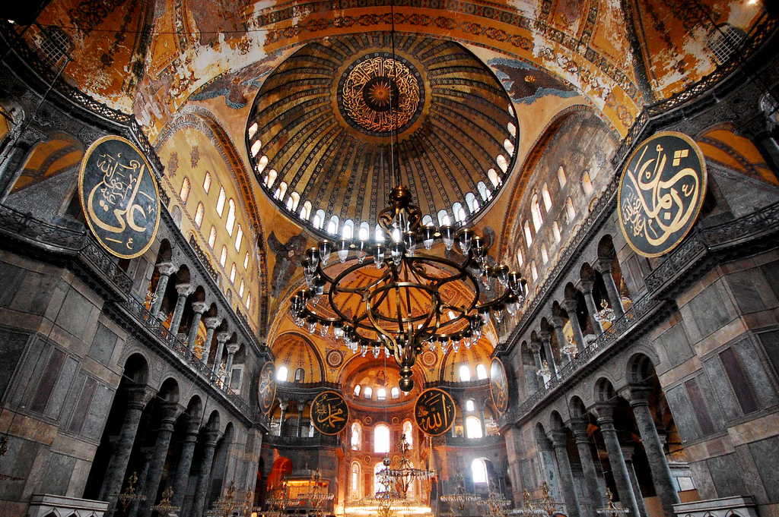
Hagia Sophia (537)

Slide 16
Ibn Battuta’s Travels

Slide 17
Ibn Battuta A Gift to Those Who Contemplate the Wonders of Cities and the Marvels of Travelling

Slide 19
The Fundamental Structure of Academic Argument

Slide 20
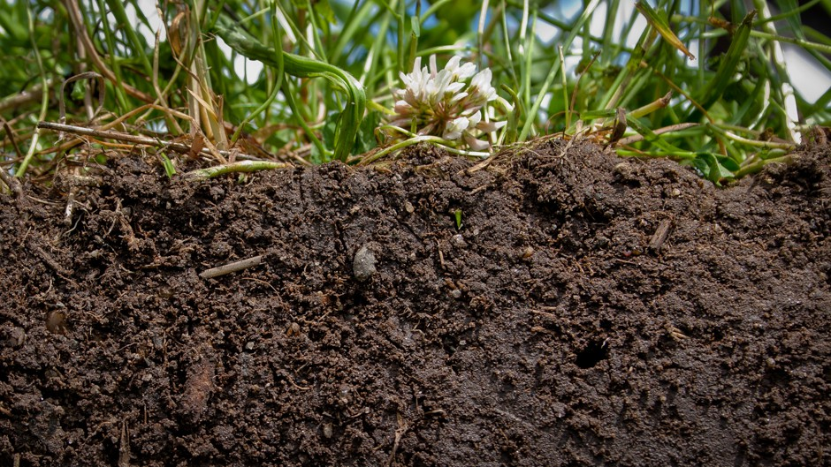
How to read an argument (aka how to read for the conversation)

Slide 21
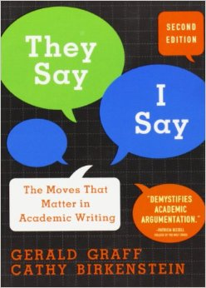
Academic Argument: Welcome to the Party
You come late. When you arrive, others have long preceded you, and they are engaged in a heated discussion, a discussion too heated for them to pause and tell you exactly what it is about . . . . You listen for a while, until you decide that you have caught the tenor of the argument; then you put in your oar. Someone answers; you answer him; another comes to your defense; another aligns himself against you. . . . The hour grows late, you must depart. And you do depart, with the discussion still vigorously in progress.
- Kenneth Burke, The Philosophy of Literary Form
Notes:
A social situation that many of you may be familiar with – a few friends are in the middle of a conversation, you approach, but start by listening before you add your own thoughts. Maybe you have to run off to class, and as you do, they’re still talking.

Slide 22
Reading for the Argument
What the most successful college students do, in my experience, is cut through the clutter of jargons, methods and ideological differences to locate the common practices of argument and analysis hidden behind it all.
-Gerald Graff, “An Argument Worth Having” NYT 9/5/2009

Slide 23
They say . . .
I say . . .
[I = the author of the academic argument]
So what?
Notes:
Most of the pieces of academic argument can be divided into three broad categories: THEY SAY, I SAY, and SO WHAT?

Slide 24
They Say =
a persistent problem, question, or puzzle
current answer(s) to that question or problem
I Say =
shows a flaw or omission or implication in what “they say”
offers a new, better answer
So what? =
why this matters; what’s at stake
Notes:
Each of these terms stand in for a handful of ideas. Do you associate any of these ideas with other terms we’ve already used in the course?
PROBLEM/QUESTION, THESIS, MOTIVE

Slide 25
Notes:
Why dirt? Because SCIENCE!

Slide 26
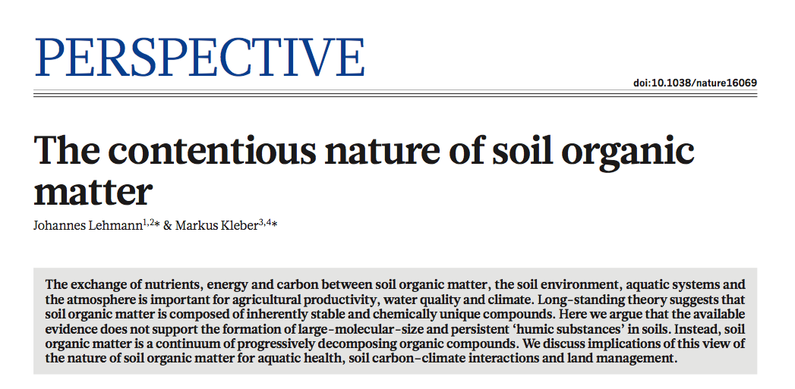
Notes:
A generic, but well-formed abstract from the science journal NATURE.

Slide 27
The exchange of nutrients, energy and carbon between soil organic matter, the soil environment, aquatic systems and the atmosphere is important for agricultural productivity, water quality and climate.
Long-standing theory suggests that soil organic matter is composed of inherently stable and chemically unique compounds.
Here we argue that the available evidence does not support the formation of large-molecular-size and persistent “humic substances” in soils.
Instead, soil organic matter is a continuum of progressively decomposing organic compounds.
We discuss implications of this view of the nature of soil organic matter for aquatic health, soil carbon-climate interactions and land management.
Notes:
We are looking for They Say, I Say, & So What. I’ll read the sentences out loud, and you listen for whether each sentence fits into THEY SAY, I SAY, or SO WHAT. Are there certain words that seem to indicate which category the sentence falls into?

Slide 28
The exchange of nutrients, energy and carbon between soil organic matter, the soil environment, aquatic systems and the atmosphere is important for agricultural productivity, water quality and climate.
Long-standing theory suggests that soil organic matter is composed of inherently stable and chemically unique compounds.
Here we argue that the available evidence does not support the formation of large-molecular-size and persistent “humic substances” in soils.
Instead, soil organic matter is a continuum of progressively decomposing organic compounds.
We discuss implications of this view of the nature of soil organic matter for aquatic health, soil carbon-climate interactions and land management.
Notes:
YEP, here are those words

Slide 29
Fundamental Structure of Academic Argument: 5 Elements
Problem
Established View
Flaw
Thesis
Motive
--Will Evans, “‘The Elements’ of Hopkins Expos”
Notes:
These are the five elements that are common to academic argument in every discipline. Some of them you are already familiar with.

Slide 30
They Say
Problem
Established View (EV)
An ongoing, persistent problem or question—something that is difficult to understand.
Flag words: explore, raise questions about
A voice in the ongoing conversation about the problem. A proposed solution to the problem.
Flag words: widely believed, some have argued

Slide 31
I Say
Flaw
Thesis
Some concern that the author raises about the validity of the EV. The essay points to a flaw/flaws in the logic of the EV, or in the EV’s use of evidence, or in the assumptions the EV makes, or the implications of the EV.
Flag words: however, but, yet.
The author corrects the flaw in the EV; it offers a new, better view in place of the original EV.
Flag words: instead, rather, therefore.

Slide 32
So what?
Motive
Tells the reader why any of this matters in the first place. Answers the questions So what? and What’s at stake? Signaled by phrases that direct us outward toward a larger, more important topic, something larger at stake—ethical implications, for instance.
Flag words: important to consider, significant.

Slide 33
Elements of Academic Argument
Problem
Established View
Flaw
Thesis
Motive
something difficult to understand; an ongoing conversation/question
a voice in the conversation; a proposed solution/answer
a concern about the EV’s validity
correction of the flaw; a better view; the product of the analysis
why this is important?; what’s at stake?; so what?
Notes:
The Five Elements in sum. Where do you see each of these elements in the sample abstract that I’ve handed out to you?

Slide 34
The exchange of nutrients, energy and carbon between soil organic matter, the soil environment, aquatic systems and the atmosphere is important for agricultural productivity, water quality and climate.
Long-standing theory suggests that soil organic matter is composed of inherently stable and chemically unique compounds.
Here we argue that the available evidence does not support the formation of large-molecular-size and persistent “humic substances” in soils.
Instead, soil organic matter is a continuum of progressively decomposing organic compounds.
We discuss implications of this view of the nature of soil organic matter for aquatic health, soil carbon-climate interactions and land management.
Notes:
YEP, here are those words

Slide 35
Exercise: Fundamental Structure of Academic Argument
Historians have long recognized Italian preponderance in Mediterranean commerce during the late Middle Ages. More recently, studies have greatly enriched our understanding of how cross-cultural communication helped foster Italian mercantile relations in foreign, non-European markets (Epstein, 2007). Yet surprisingly, a corpus of material that constitutes a valuable documentary record of the Italian merchant’s education and understanding of Islamic and Crimean cultures remains untouched: pratiche della mercatura, or “manuals of commercial practice”. These handbooks, widely circulated throughout central and northern Italy, contained vital information pertaining to the merchant’s understanding and awareness of Arabic-Turkic cultures and customs outside the realm of commercial affairs. Taking these manuals as its documentary focus, this essay proposes new ways of reading and classifying these texts whilst exploring Italian mercantile conceptions of the non-Western Mediterranean world. Indeed, the cross-cultural understanding and exchange gleaned from their pages suggest these manuals were imperative tools used by the Italian merchant in negotiating trade with the so-called “Other.”
Joseph F. Stanley, “Negotiating Trade: Merchant Manuals and Cross-Cultural Exchange in the Medieval Mediterranean”

Slide 36
Exercise: Fundamental Structure of Academic Argument
Historians have long recognized Italian preponderance in Mediterranean commerce during the late Middle Ages. More recently, studies have greatly enriched our understanding of how cross-cultural communication helped foster Italian mercantile relations in foreign, non-European markets (Epstein, 2007). Yet surprisingly, a corpus of material that constitutes a valuable documentary record of the Italian merchant’s education and understanding of Islamic and Crimean cultures remains untouched: pratiche della mercatura, or “manuals of commercial practice”. These handbooks, widely circulated throughout central and northern Italy, contained vital information pertaining to the merchant’s understanding and awareness of Arabic-Turkic cultures and customs outside the realm of commercial affairs. Taking these manuals as its documentary focus, this essay proposes new ways of reading and classifying these texts whilst exploring Italian mercantile conceptions of the non-Western Mediterranean world. Indeed, the cross-cultural understanding and exchange gleaned from their pages suggest these manuals were imperative tools used by the Italian merchant in negotiating trade with the so-called “Other.”
Joseph F. Stanley, “Negotiating Trade: Merchant Manuals and Cross-Cultural Exchange in the Medieval Mediterranean”

